Slide 1


KATION
WQD 7005 DATA MINING
Evaluating Telco Campaign Performance
And
Predicting Campaign Offer Takers
KHAR SHIN YIN (S2145827) LEE SHIN EE (S2132380) OOI SHI YUAN (17088226) SIM LIN ZHENG (S2102170) YU YUEN HERN (S2121801)

Slide 2

Content
Introduction
Analysis Goal & Objective
Dataset Description
SEMMA: Sample
SEMMA: Explore
SEMMA: Modify
SEMMA: Model
SEMMA: Assess
Conclusion

Slide 3

Introduction
Platform migration in Kation
An initiative called ‘Right Planning’ is conducted
– to migrate old rate plans to new rate plans
Business goal: To standardize the rate plans & enhance customers’ experience and users’ experience.
Decided to launch a pilot campaign.

Slide 4

Analysis Goal & Objective
To assess pilot campaign performance before implementing to the entire customer base.
To evaluate the effectiveness of ‘Right Planning’ pilot campaign.
To determine campaign takers’ profile.
To predict campaign takers based on usage and revenue behavior.

Slide 5

Dataset Description
Campaign data in customer level
Demographic
Usage before and after campaign
Revenue before and after campaign
Status before and after campaign

Slide 6



Demographic & Status
Usage
Revenue
ID
TENURE
AGE
GENDER
NATIONALITY
STATE
STATUS_BEFORE
STATUS_AFTER
OFFER_TAKER
OFFER_TAKE_UP_DT
ACTIVITY_DAYS_AFTER
ACTVIITY_STATUS_AFTER
DATA_USG_BEFORE
DATA_USG_AFTER
DATA_PURC_BEFORE
DATA_PURC_AFTER
RLD_IND_BEFORE
RLD_IND_AFTER
VOICE_USG_BEFORE
VOICE_USG_AFTER
ARPU_BEFORE
ARPU_AFTER
CPA_RVN_BEFORE
CPA_RVN_AFTER
DATA_CHRG_BEFORE
DATA_CHRG_AFTER
RLD_AMT_BEFORE
RLD_AMT_AFTER
01
02

Slide 7
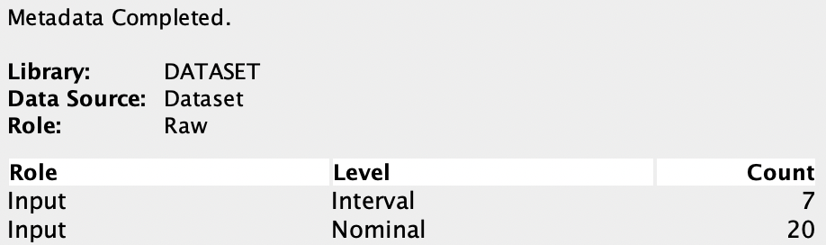

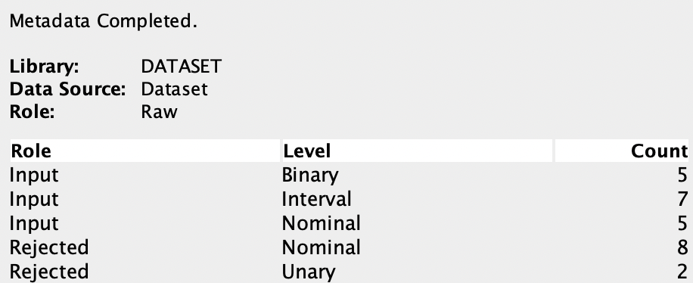
Sample
Explore
Modify
Model
Assess
Sample
7272 records, 27 features
Basic
Advance

Slide 8
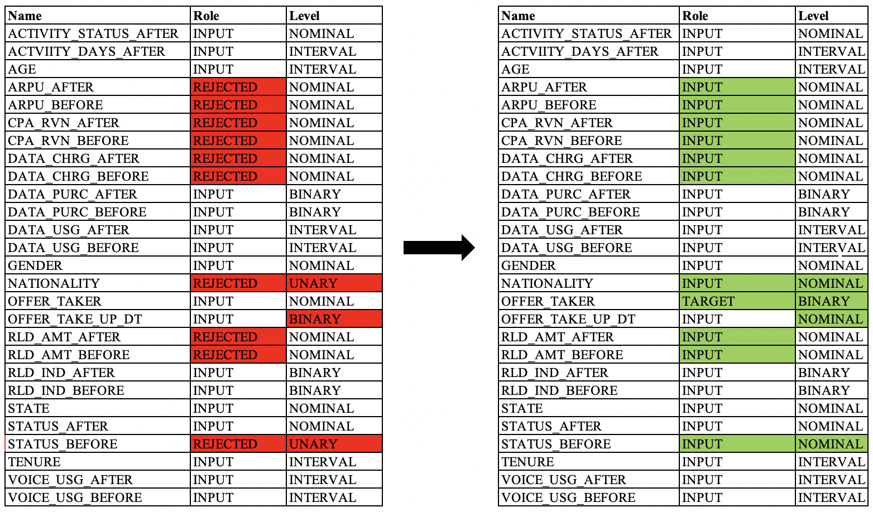
Sample
Explore
Modify
Model
Assess
Sample
Reclassification
Advance
Manual

Slide 9
Sample
Explore
Modify
Model
Assess
Explore
Univariate Analysis
STATE
GENDER
AGE
Inconsistent
Intentional
ARPU_BEFORE
ARPU_AFTER
CPA_RVN_BEFORE
CPA_RVN_AFTER
DATA_CHRG_BEFORE
DATA_CHRG_AFTER
RLD_AMT_BEFORE
RLD_AMT_AFTER
Noisy
&
Incomplete
OFFER_TAKE_UP_DT
Incomplete
There are 4 issues found: Intentional, Noisy, Incomplete & Inconsistent data
Perform data cleaning during Modify stage.

Slide 10
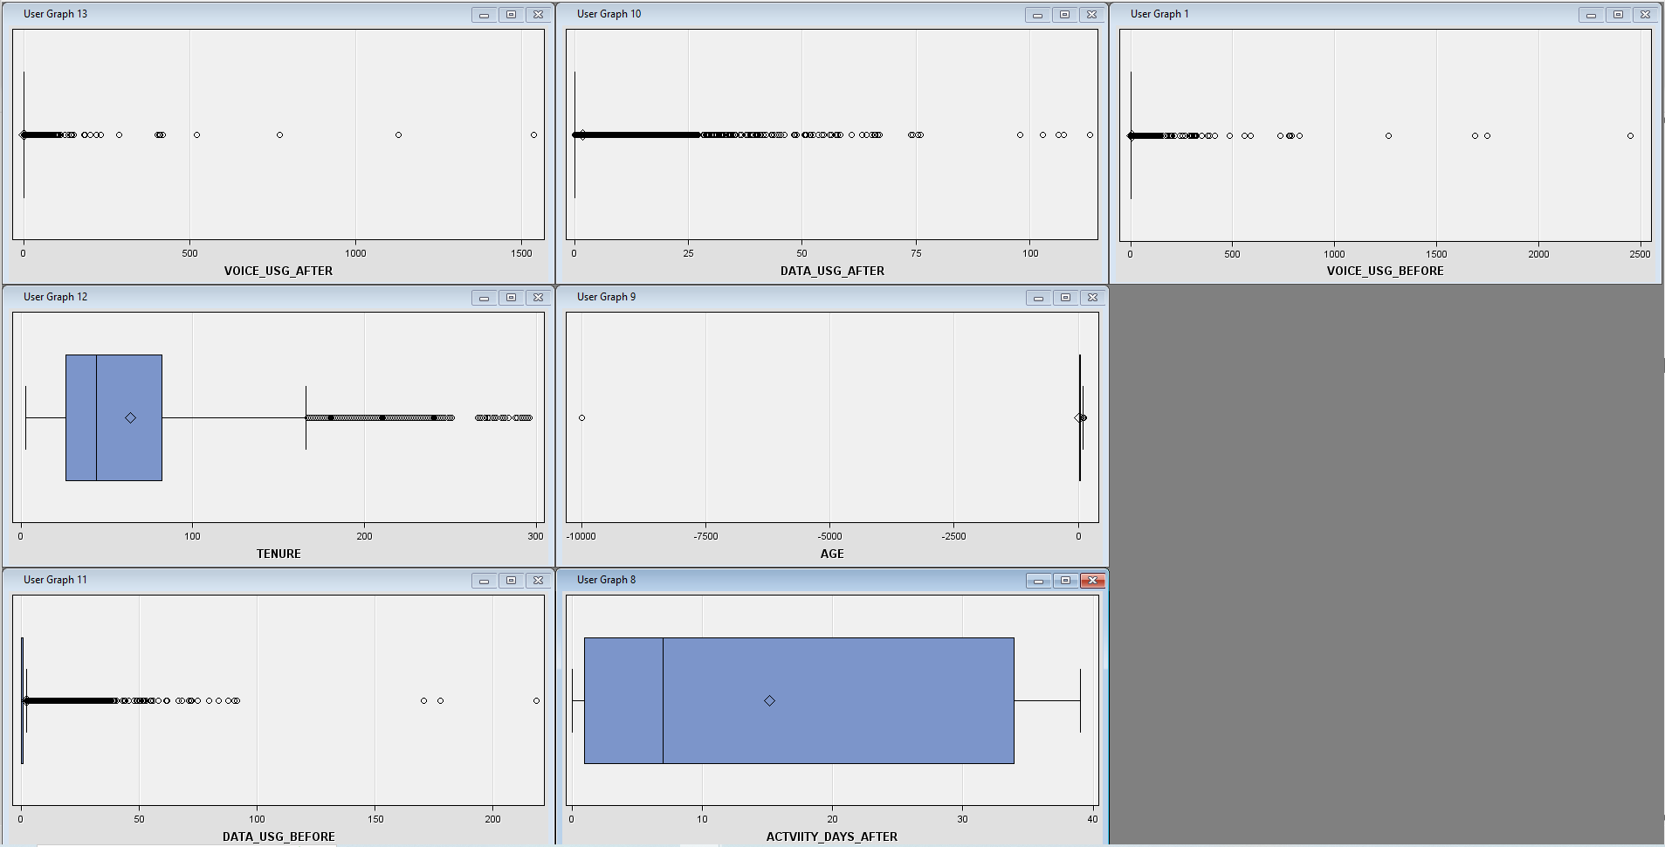


Sample
Explore
Modify
Model
Assess
Explore
Univariate Analysis | Boxplot
Intentional data ‘-9999’ to remove
No missing values
All right-skewed distribution
Outliers and noisy data detected

Slide 11
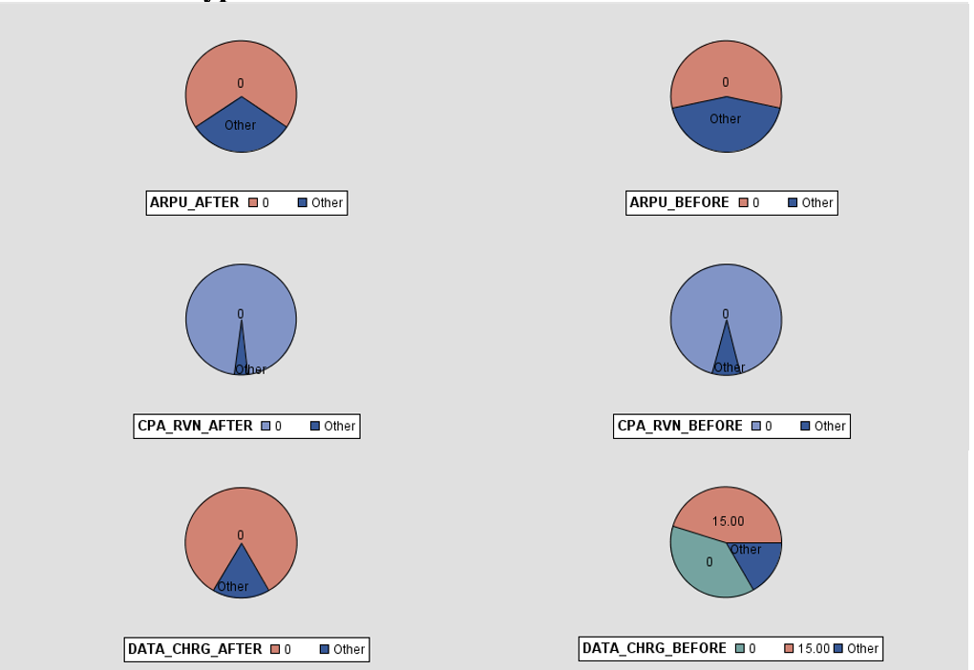
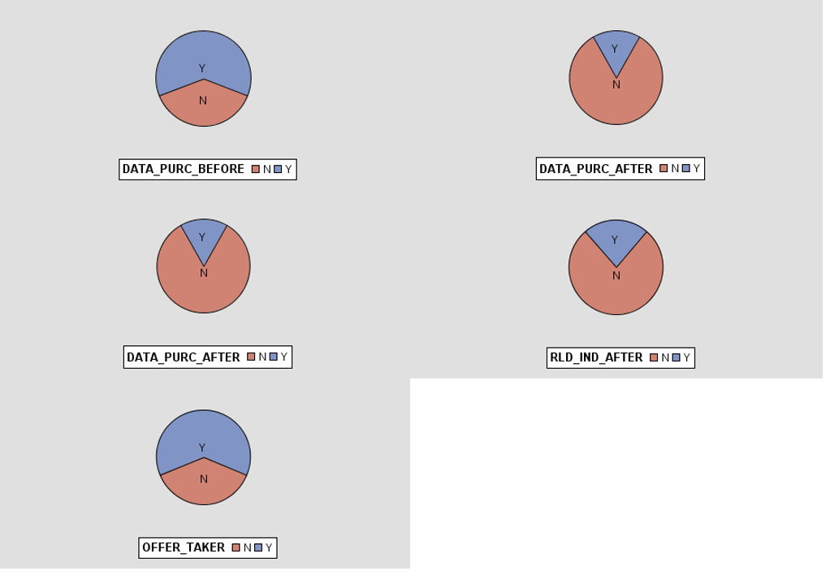
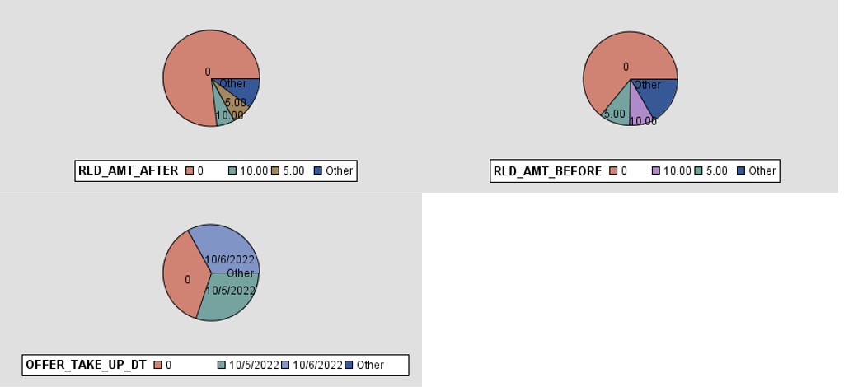
Sample
Explore
Modify
Model
Assess
Explore
Univariate Analysis | Pie chart
Nominal variables
Many missing values
Wrongly tagged as nominal

Slide 12
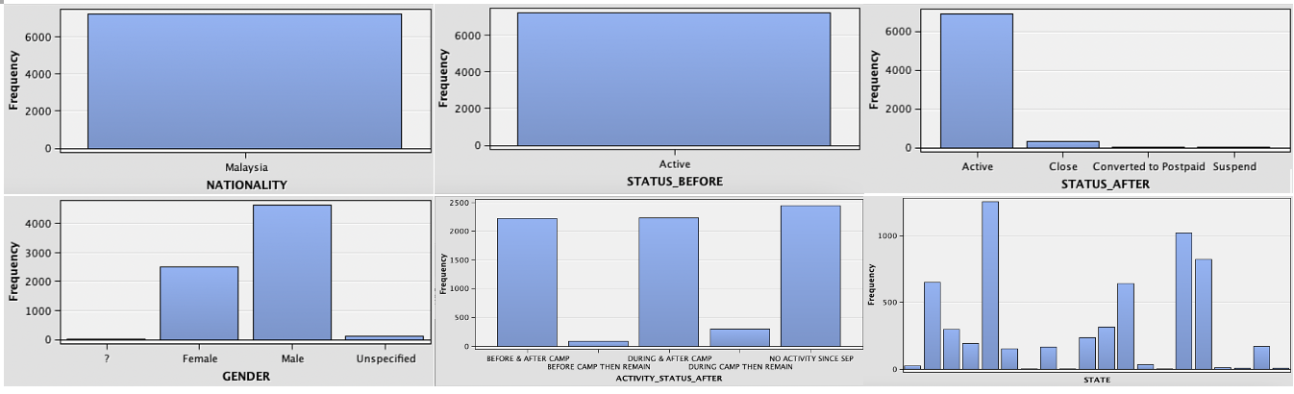
Sample
Explore
Modify
Model
Assess
Explore
Univariate Analysis | Bar Chart
Inconsistent value:
‘?’ and ‘unspecified’ is same
Inconsistent value:
more than 13 states

Slide 13
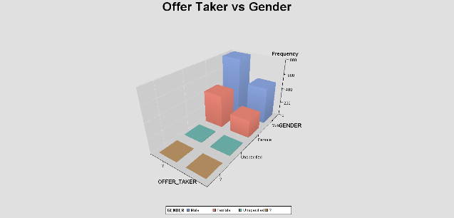
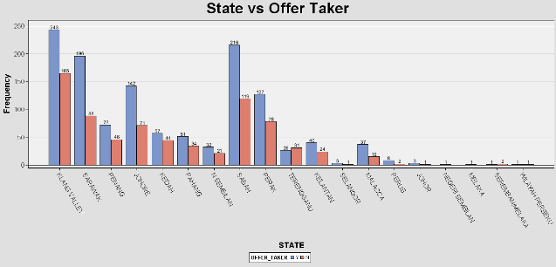
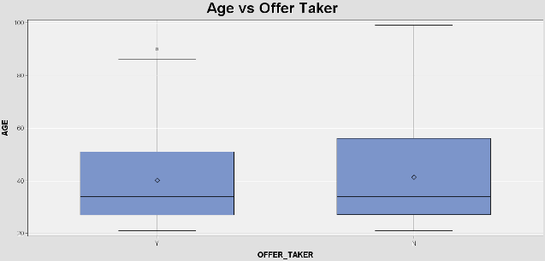
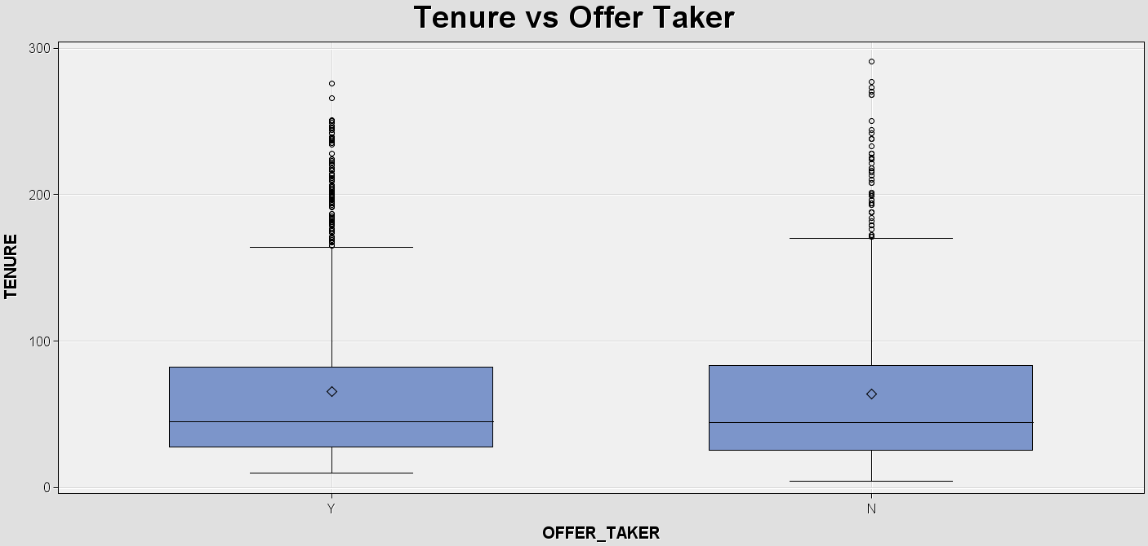
Sample
Explore
Modify
Model
Assess
Explore
Bivariate Analysis
Miss out vs tenure
Males likely to join campaign, most participants from Klang Valley, median age of 34 for both, median tenure of ~45
Notes:
Upon closer inspection, males are more likely to join the campaign compared to female
Most participants from Klang Valley (a lot of people in KL/Selangor identify themselves as Klang Valley)
Same median age
Same median tenure

Slide 14
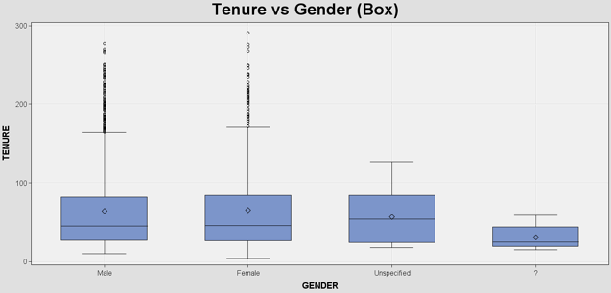
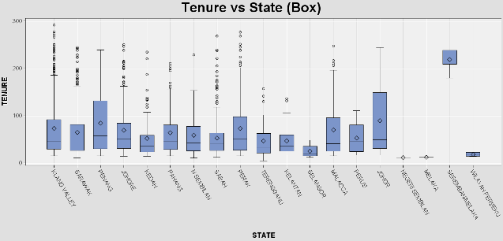
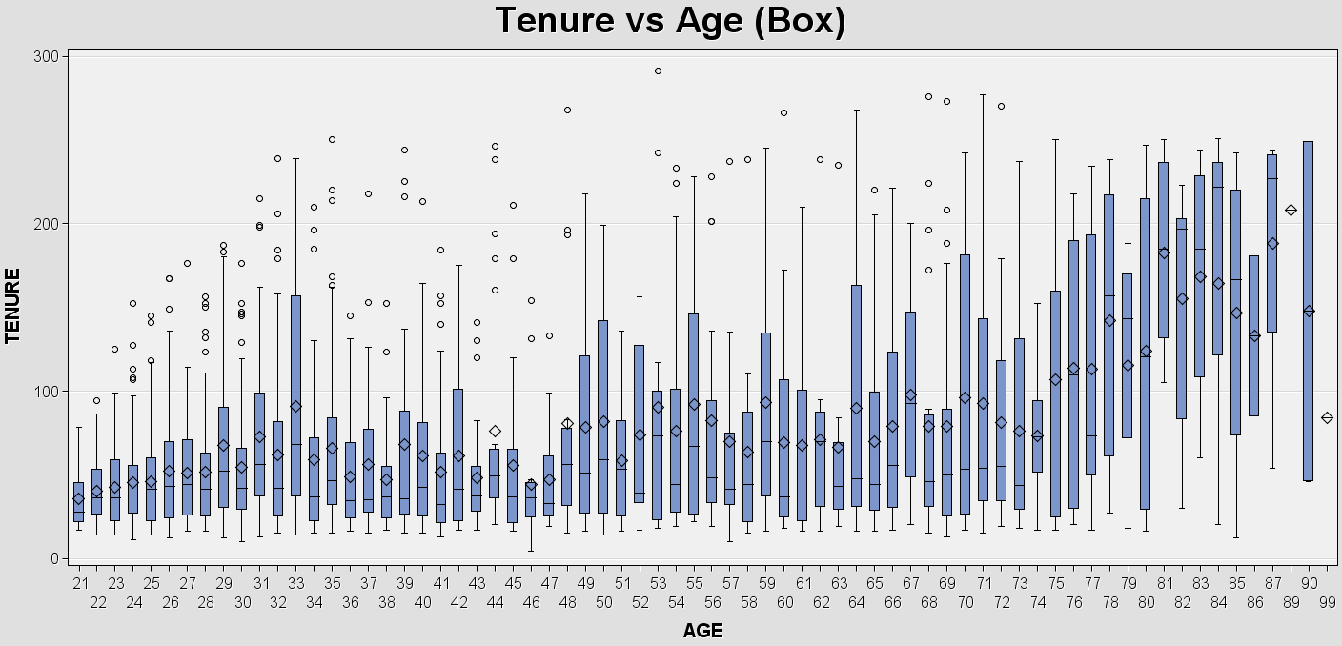
Sample
Explore
Modify
Model
Assess
Explore
Bivariate Analysis
Similar tenure distribution for both male & female
Younger age = shorter tenure
Varying tenure period in all states – surprisingly short tenures in Kedah

Slide 15
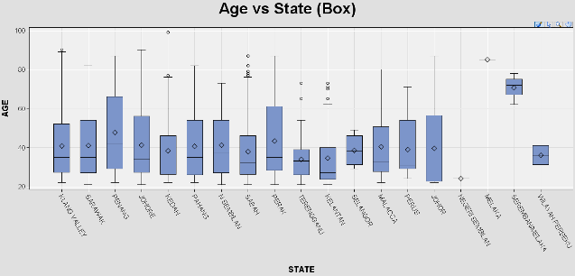
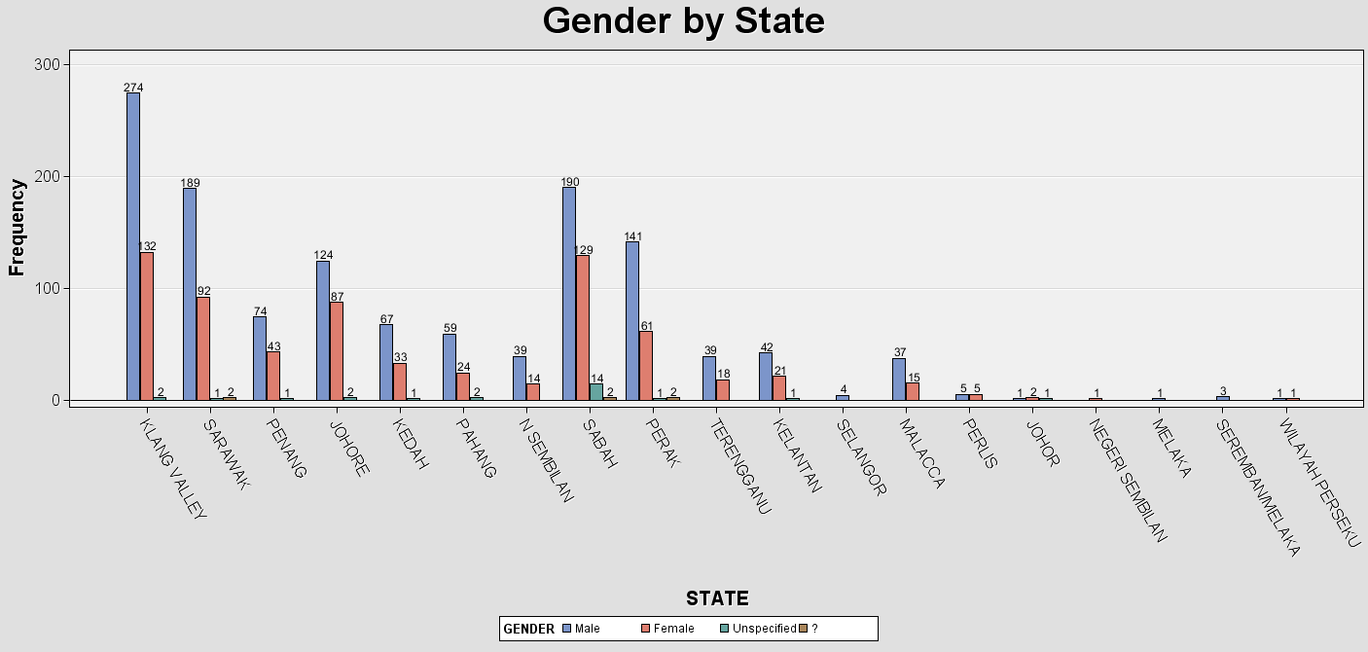
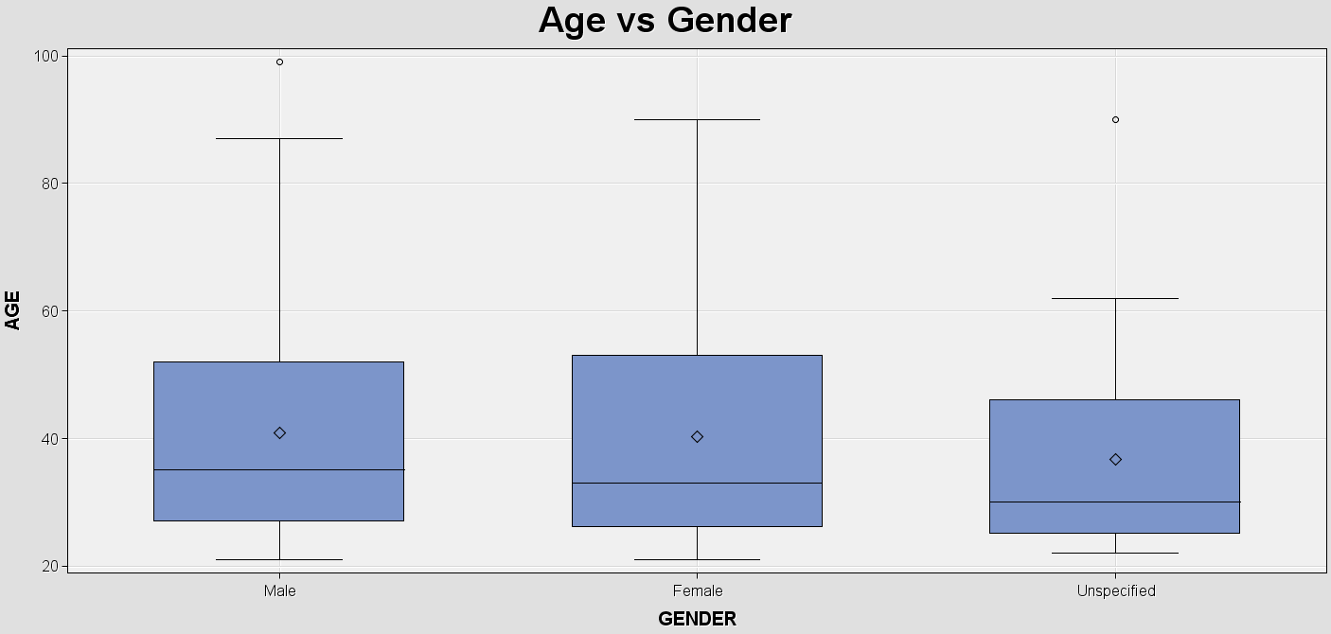
Sample
Explore
Modify
Model
Assess
Explore
Bivariate Analysis
Age vs gender
Gender vs state
Exceptionally young group of participants in Terengganu and Kelantan
Similar median age for male and female (~34)
Sabah has the most customers with undisclosed gender
Notes:
Kation's campaign appeals a lot to the customers in Terengganu and Kelantan

Slide 16
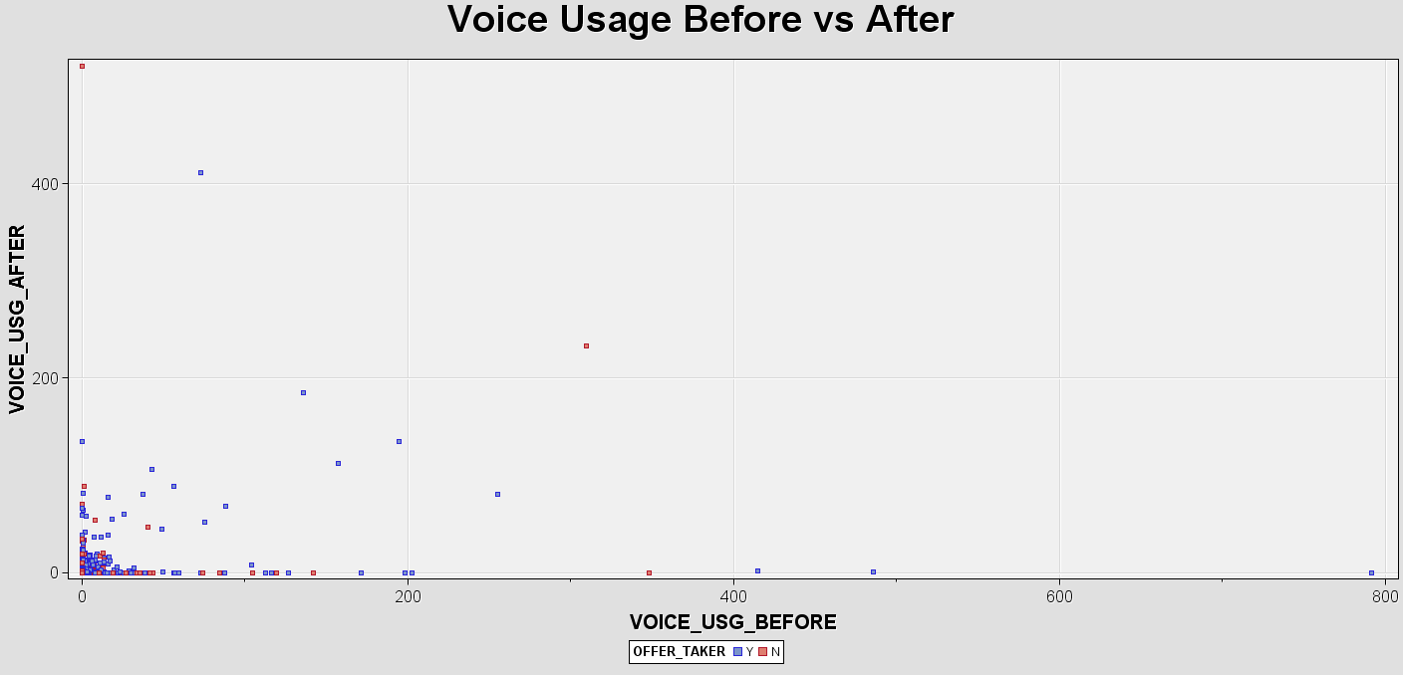
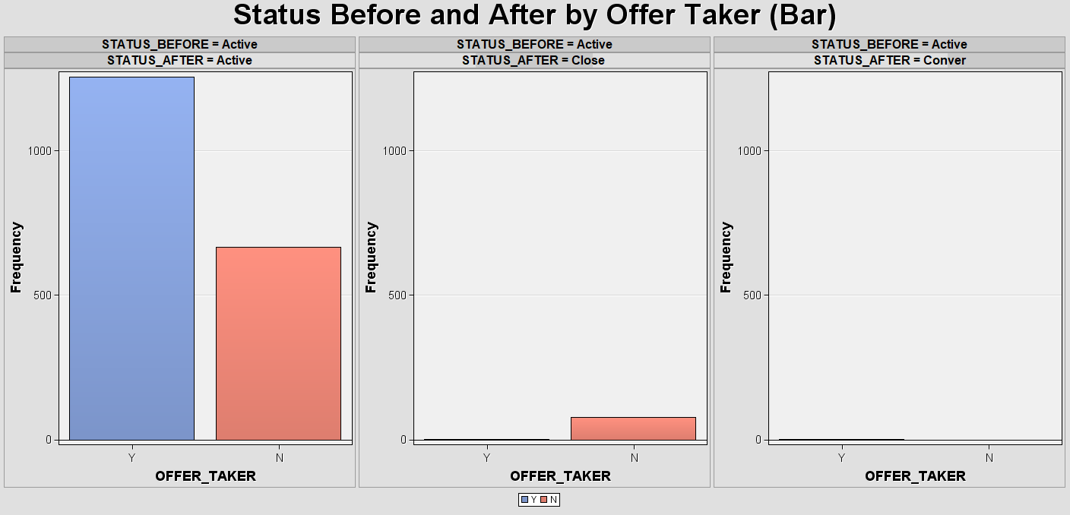
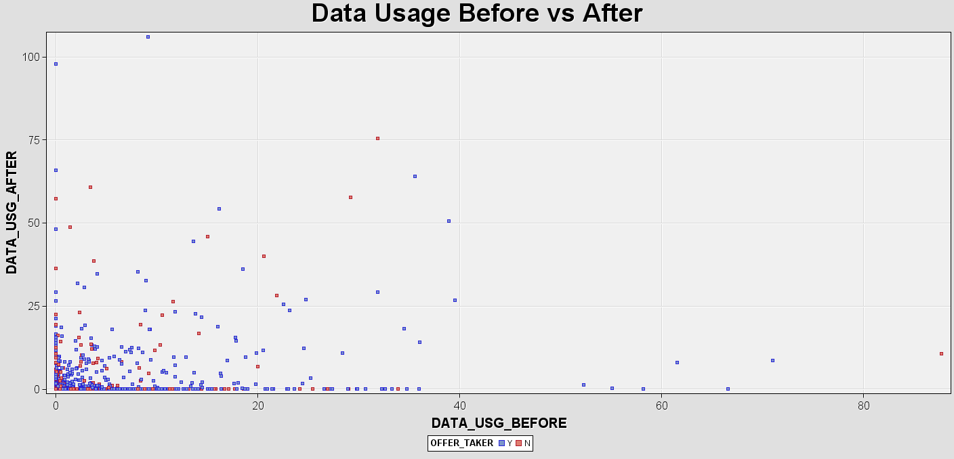
Sample
Explore
Modify
Model
Assess
Explore
Multivariate Analysis
Age vs gender
Gender vs state
The data and voice usage before and after campaign looks dispersed and exhibit no obvious relationship
Takers more likely to remain active while non-takers more likely to churn

Slide 17
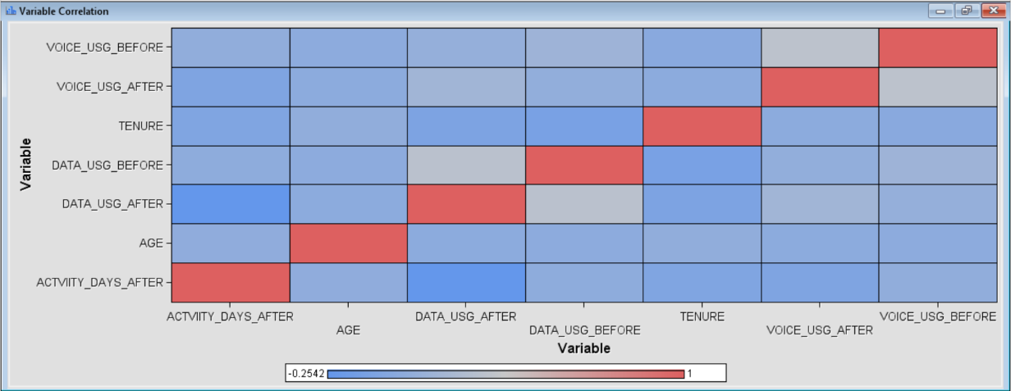
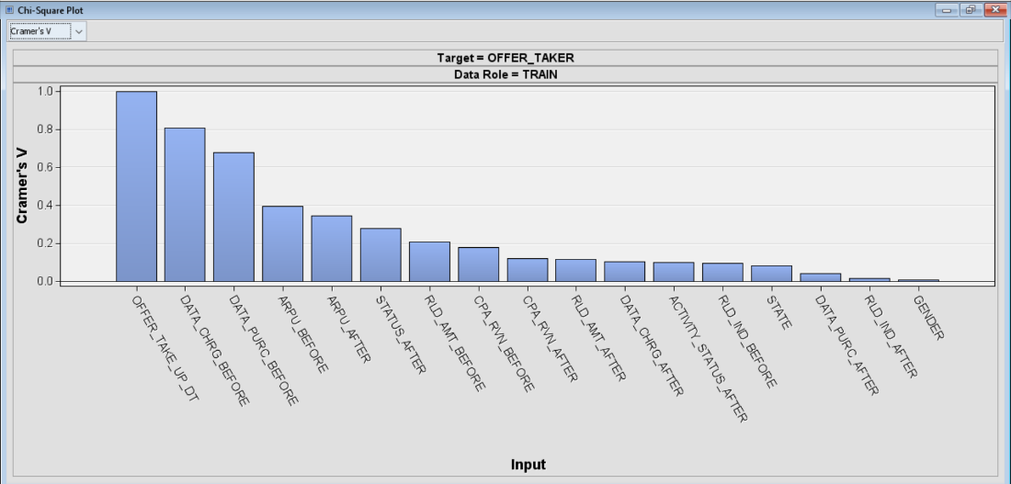
Sample
Explore
Modify
Model
Assess
Explore
Correlation Analysis
For interval variables:
No correlation value > 0.9
No variables were removed
For nominal variables:
OFFER_TAKE_UP_DT showed a prefect association

Slide 18
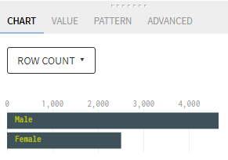
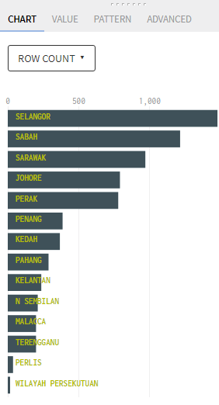
Sample
Explore
Modify
Model
Assess
Modify
Modifying Inconsistent Data
STATE:
Initial: Naming consist of mixture of Malay and English
Current: English naming
GENDER:
Initial: Male, Female, Unspecified, and ‘?’
Current: Male, Female
* ‘Unspecified’ and ‘?’ were removed

Slide 19
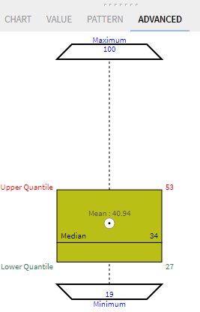
Sample
Explore
Modify
Model
Assess
Modify
Modifying Intentional Data
AGE:
Records with values of ‘-9999’ are removed
Boxplot shows no outlier were detected

Slide 20
Sample
Explore
Modify
Model
Assess
Modify
Modifying Incomplete Data
Variables involved:
ARPU_BEFORE
ARPU_AFTER
CPA_RVN_BEFORE
CPA_RVN_AFTER
DATA_CHRG_BEFORE
DATA_CHRG_AFTER
RLD_AMT_BEFORE
RLD_AMT_AFTER
OFFER_TAKE_UP_DT
Value ‘?’ is replaced with 0
Data type converted from string to integer
OFFER_TAKE_UP_DT remained as string as non-offer taker will not have date

Slide 21
Sample
Explore
Modify
Model
Assess
Modify
Modifying Noisy Data (Outlier)
Variables involved:
ARPU_BEFORE
ARPU_AFTER
CPA_RVN_BEFORE
CPA_RVN_AFTER
DATA_CHRG_BEFORE
DATA_CHRG_AFTER
RLD_AMT_BEFORE
RLD_AMT_AFTER
DATA_USG_BEFORE
DATA_USG_AFTER
VOICE_USG_BEFORE
VOICE_USG_AFTER
AGE
TENURE
Outliers were not removed as the extreme values are legitimate observations that were part of the sample

Slide 22
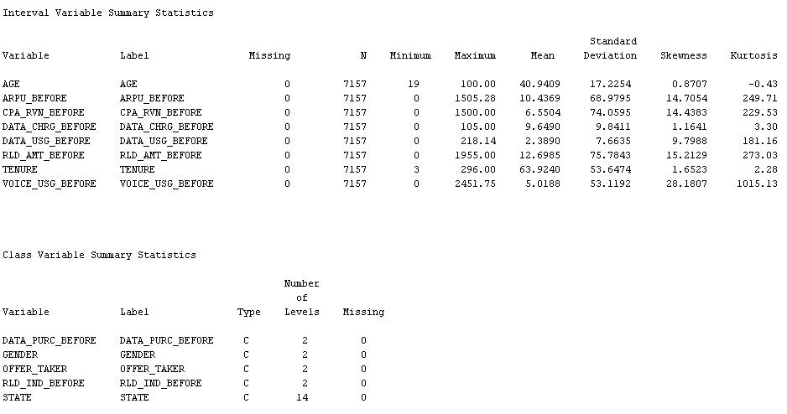
Sample
Explore
Modify
Model
Assess
Modify
Examining Exported Data for Modelling
After modification:
No missing values were found
Number of levels for class variables were correct

Slide 23
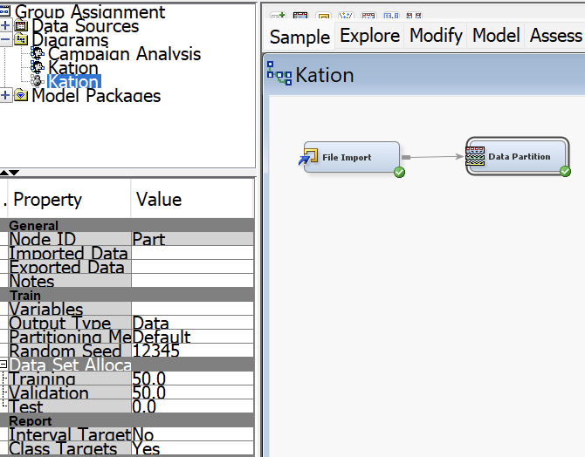
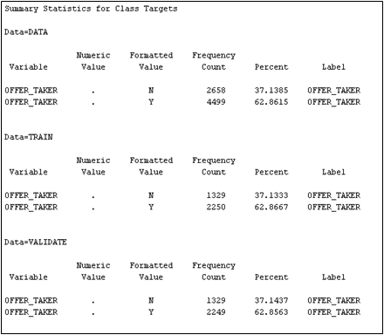
Sample
Explore
Modify
Model
Assess
Modify
Data Partition
Dataset was split into 50% to training set and 50% to validation set
Summary statistics of OFFER_TAKER

Slide 24
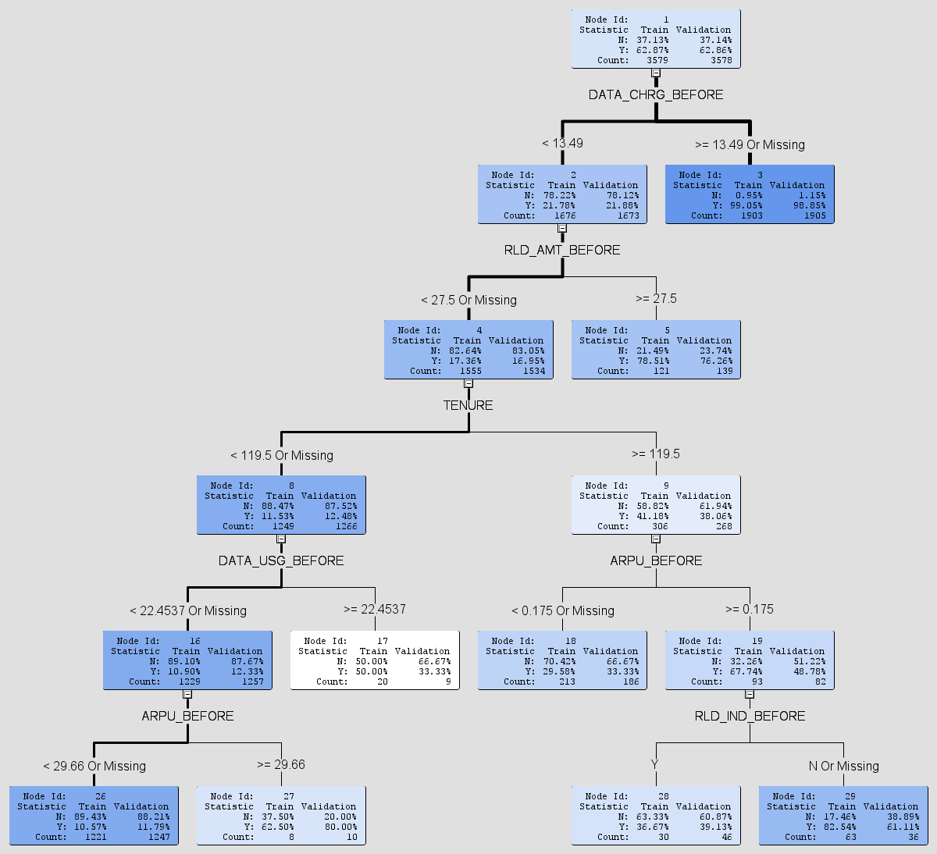
Sample
Explore
Modify
Model
Assess
Model
Decision Tree
Campaign offer takers observation:
Tends to purchase data plan with charge ≥ RM 13.49 before campaign
Tends to reload ≥ RM 27.50 although they do not purchase extra data plan before campaign
Have a longer tenure and higher ARPU

Slide 25
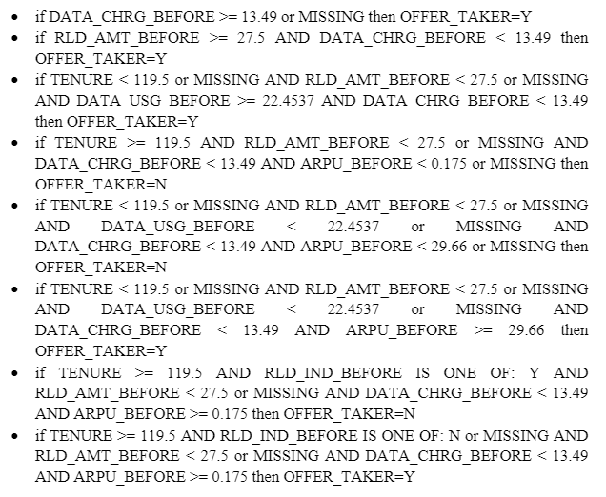
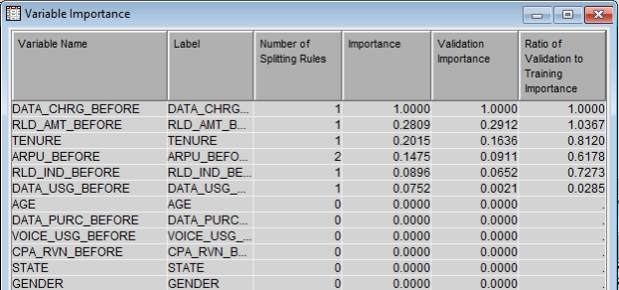
Sample
Explore
Modify
Model
Assess
Model
Decision Rules & Feature Importance
DATA_CHRG_BEFORE, RLD_AMT_BEFORE, TENURE, ARPU_BEFORE, RLD_IND_BEFORE and DATA_USG_BEFORE are the most important variables
Can be utilized on next campaign to predict potential customers to take up the offer
Rules of Decision Tree model

Slide 26
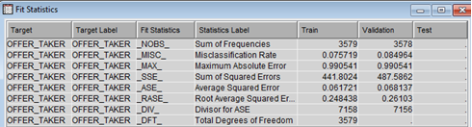
Sample
Explore
Modify
Model
Assess
Assess
Fit Statistics | Confusion Matrix
Fit Statistics:
No overfitting
Very low misclassification rate
7.6% for training set and 8.5% for validation set
Average squared error is close to 0
Metrics | Accuracy | Precision | Recall | Specificity | F1 measure
(Train) | 92.4% | 96.8% | 91.0% | 94.9% | 94.0%
(Validate) | 91.5% | 96.3% | 90.7% | 94.2% | 93.0%
Confusion Matrix:
Decision Tree has a great performance in differentiating the campaign offer takers and non-offer takers.

Slide 27

Conclusion
To assess the effectiveness of “Right Planning” pilot campaign
4573 takers (63% opt in rate)
2921 takers remain active after campaign (64% active rate)
Moderately success
01
To identify campaign takers’ profile
Target group is sample of Kation’s prepaid Malaysian
Higher opt in rate among male
Age group between 22 - 36 years old with tenure > 1 year
Mostly from Klang Valley, then Sabah and Sarawak
Evaluating Telco Campaign Performance and Predicting Campaign Offer Takers are conducted using Data Mining Techniques and SEMMA method.
02
To predict campaign takers based on usage and revenue behavior
Offer takers tends to:
Purchase data plan with charge ≥ RM 13.49
Reload ≥ RM 27.50
Have a long tenure and high ARPU
Decision Tree performed extremely good in classifying the campaign offer takers with non-offer takers.
03
03

Slide 28
That's a wrap!
Thank you.
12th Jan 2023

